Slide 1

Session 5
Managing and
Validating
ASP.NET Web
Applications

Slide 2

Session Overview
➢Describe state management and its techniques
➢List and describe commonly used validation controls in ASP.NET
➢Explain how to use LINQ with ASP.NET
➢Describe data caching
© Aptech Programming for the Web with ASP.NET MVC/Session 5
2

Slide 3
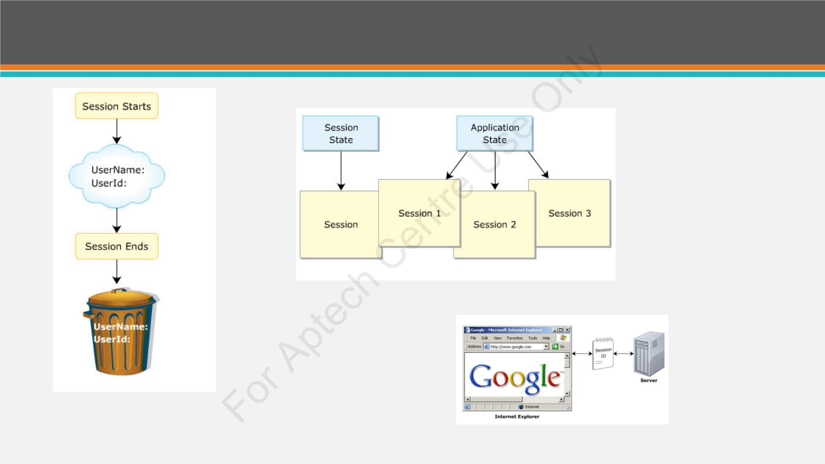
Managing State (1-2)
© Aptech Programming for the Web with ASP.NET MVC/Session 5
3

Slide 4
Managing State (2-2)
• HTTP protocol is stateless as it removes all the resources or
references working on a specific request in the past.
• State management manages page information and state over
various requests for the same or different pages.
• Two methodologies available in ASP.NET: client-side state
management and server-side state management.
© Aptech Programming for the Web with ASP.NET MVC/Session 5
4

Slide 5
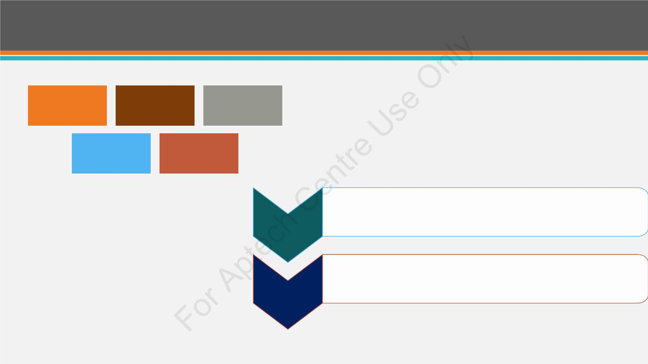
Client-side and Server-side State Management
Client-side State Management
View State
Control State
Hidden Fields
Query Strings
Cookies
Server-side State Management
• Application state information is accessible to all pages,
inspite of which user requests a page.
Application
State
• Session state information is accessible to all pages
accessed by a user during a single visit.
Session
State
© Aptech Programming for the Web with ASP.NET MVC/Session 5
5

Slide 6
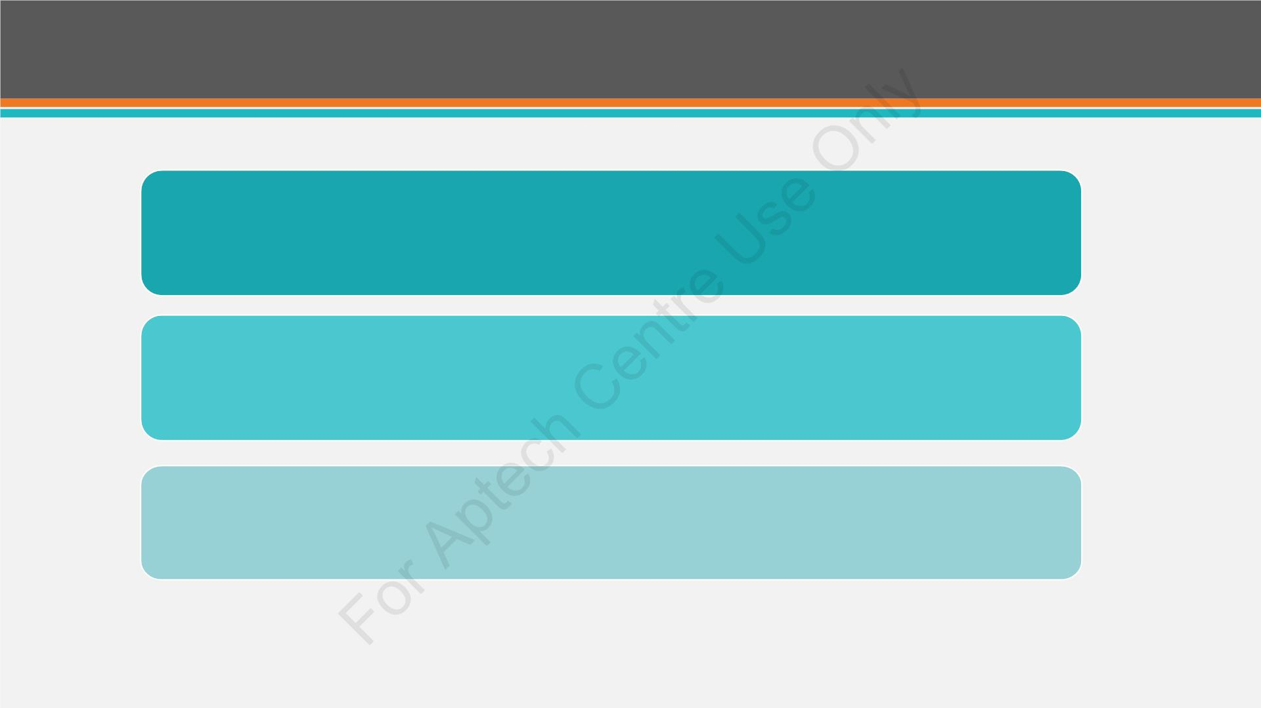
ViewState
A page-level state management technique
Used for holding data temporarily
• Able to store any type of data
• Property dependent.
© Aptech Programming for the Web with ASP.NET MVC/Session 5
6

Slide 7
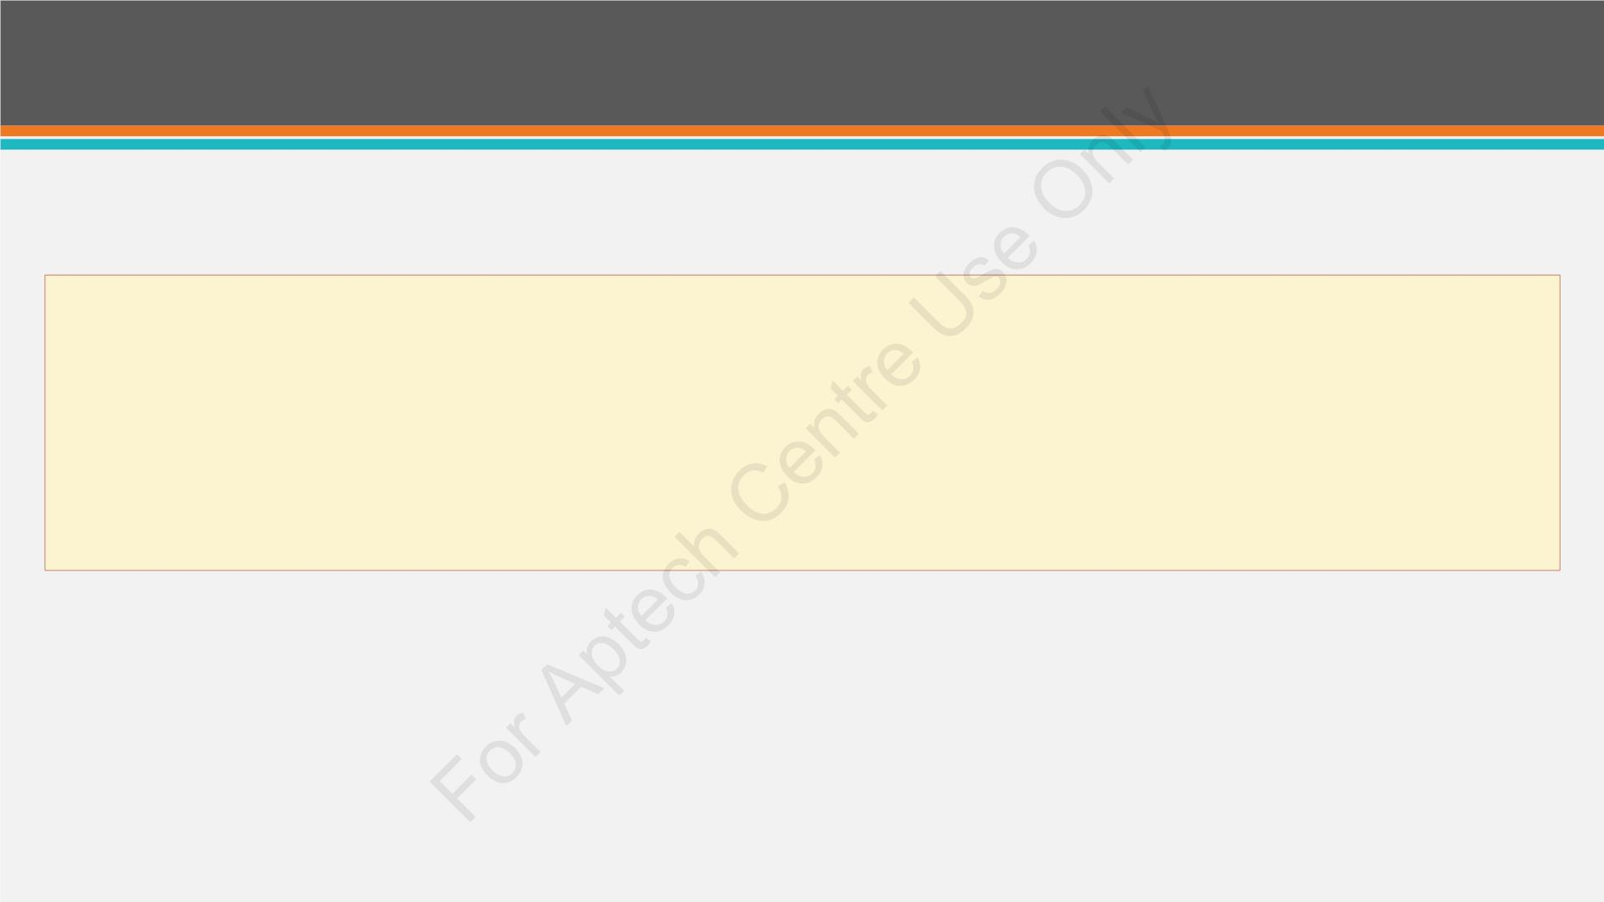
Encryption of ViewState
• To improve security and avoid disruption from hackers and malicious users, developers should
enable ViewState encryption.
• The default status of ViewStateis active.
• It can be disabled by specifying the value of EnableViewState property for each Web control
as false.
© Aptech Programming for the Web with ASP.NET MVC/Session 5
7

Slide 8
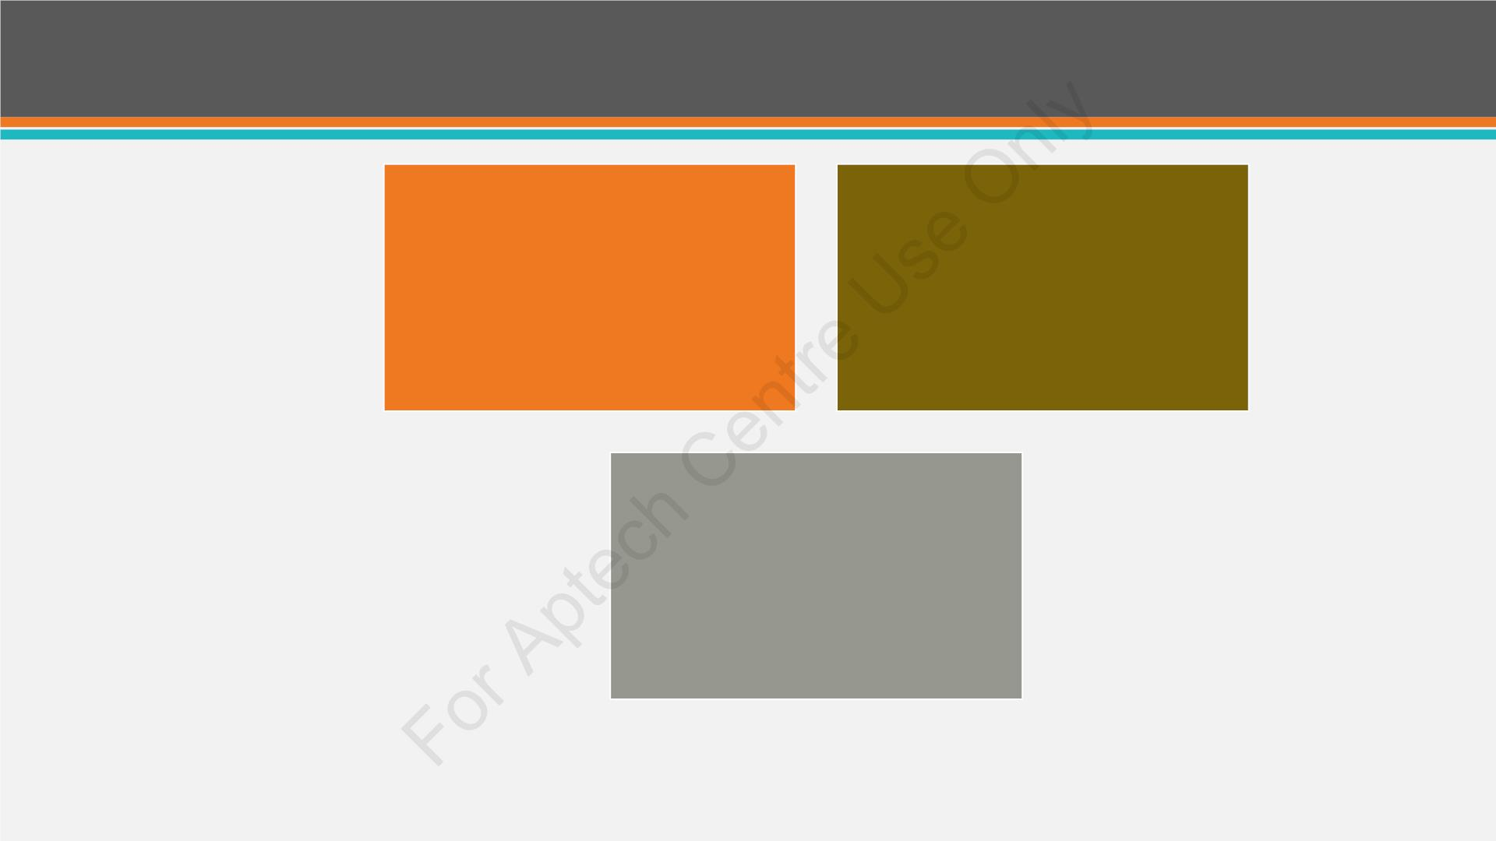
Control State
Empowering the
ViewState property
Describing a custom
view
Declaring the
ViewState property
© Aptech Programming for the Web with ASP.NET MVC/Session 5
8

Slide 9
Hidden Fields
• Hidden fields are not displayed on the user browser.
• These fields are stored in a HTML form and available only when
the form is processed.
© Aptech Programming for the Web with ASP.NET MVC/Session 5
9

Slide 10
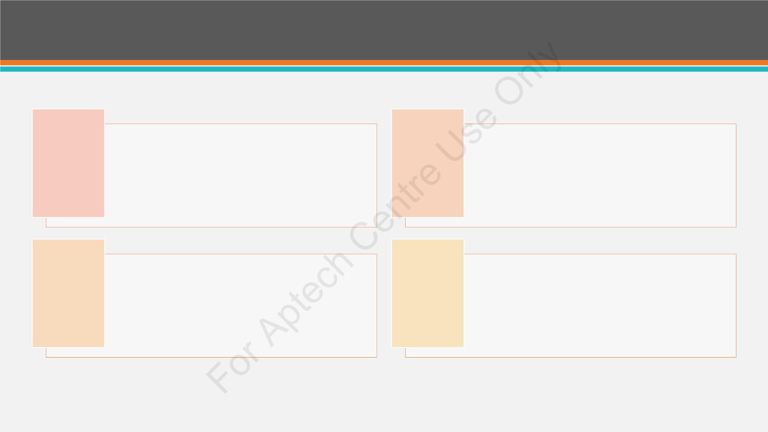
Query String
Query string is carried in the URL.
They are stored as key-value pair.
Query strings are maintained and
passed from one page to second page
and from the second page the third
page.
Response.Redirect("menu.aspx?
category=vegetarianfood");
© Aptech Programming for the Web with ASP.NET MVC/Session 5
10

Slide 11
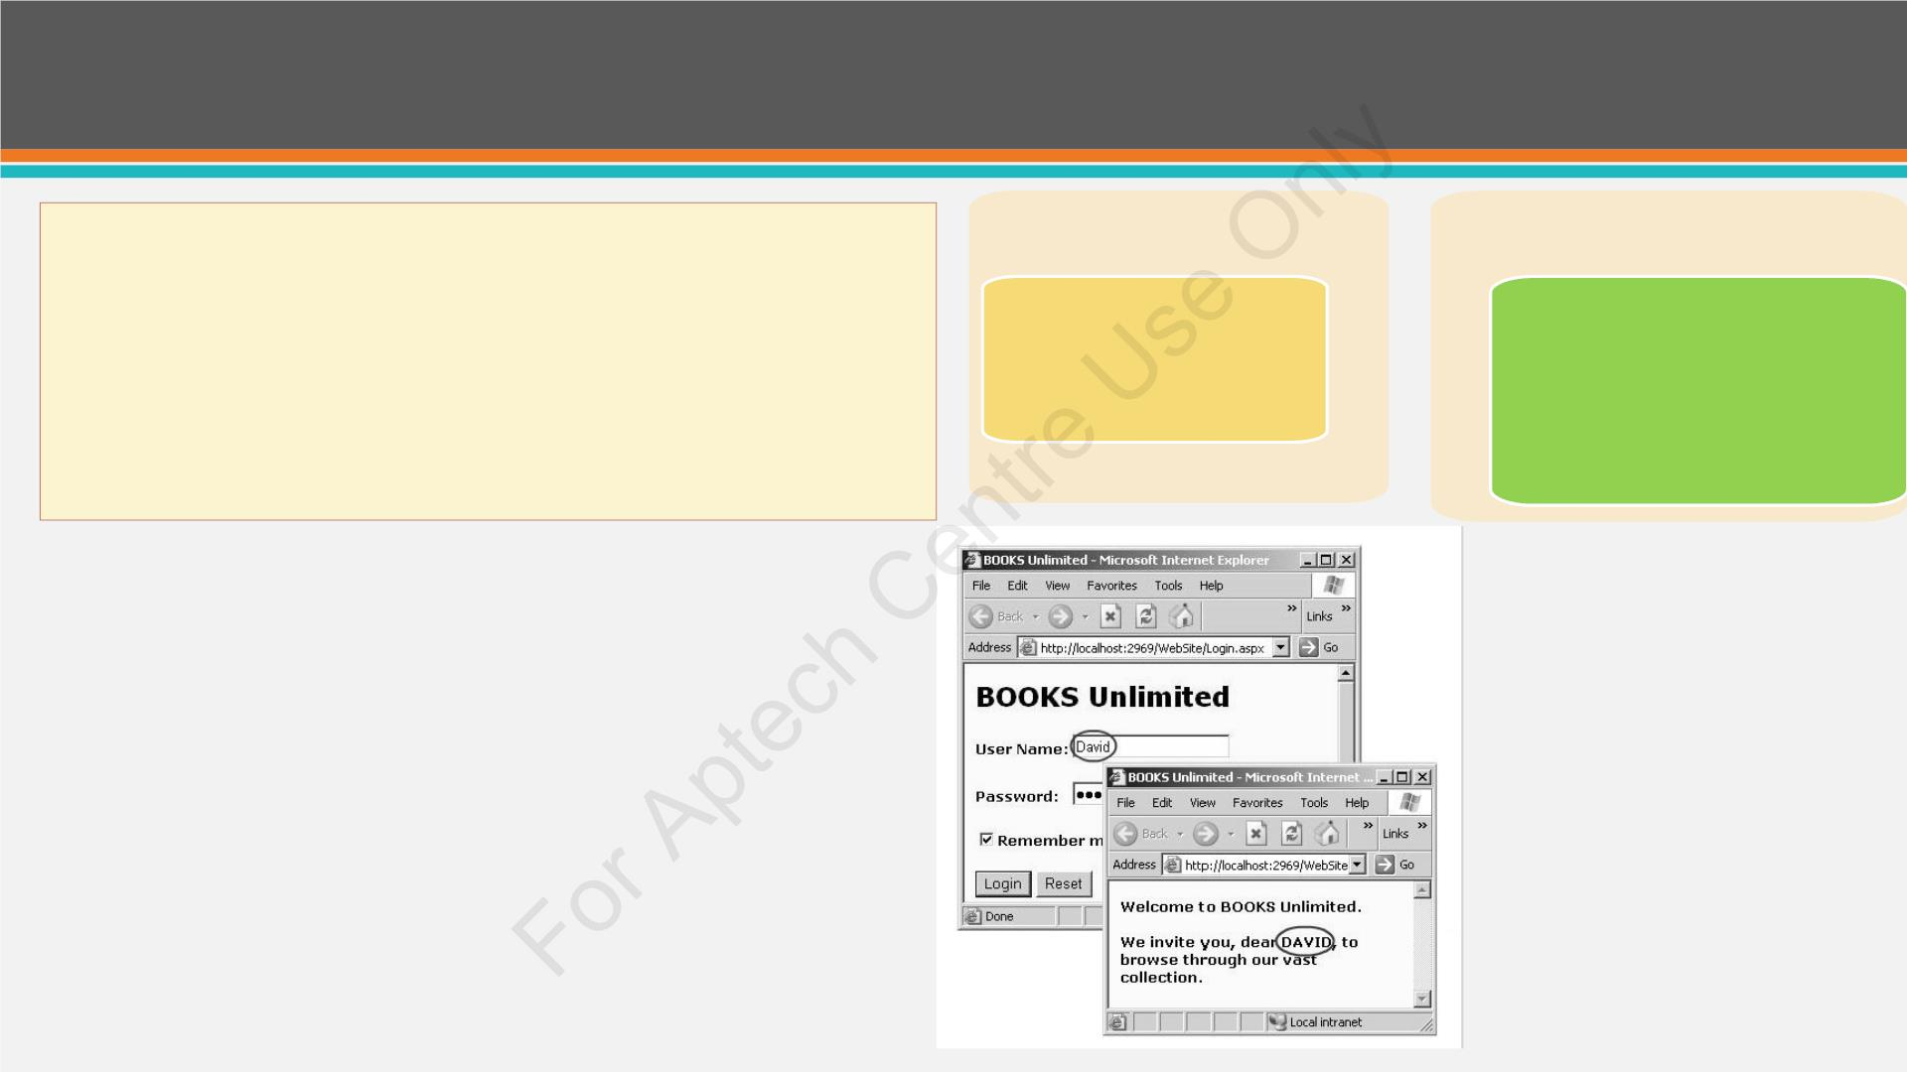
Cookies
• Cookies are small files generated in Web browser’s
Transient Co
(memory)
e
Persistent Cookie (hard disk)
memory or on the hard disk.
Accessible till the
browser runs.
Have expiry time.
When no expiry time is
set,
•
Cookies contain a key/value pair
• Cookies can also be disabled or manually deleted
treated as transient
cookies.
by users, which makes them not so effective
Examp e:
© Aptech Programming for the Web with ASP.NET MVC/Session 5
11

Slide 12
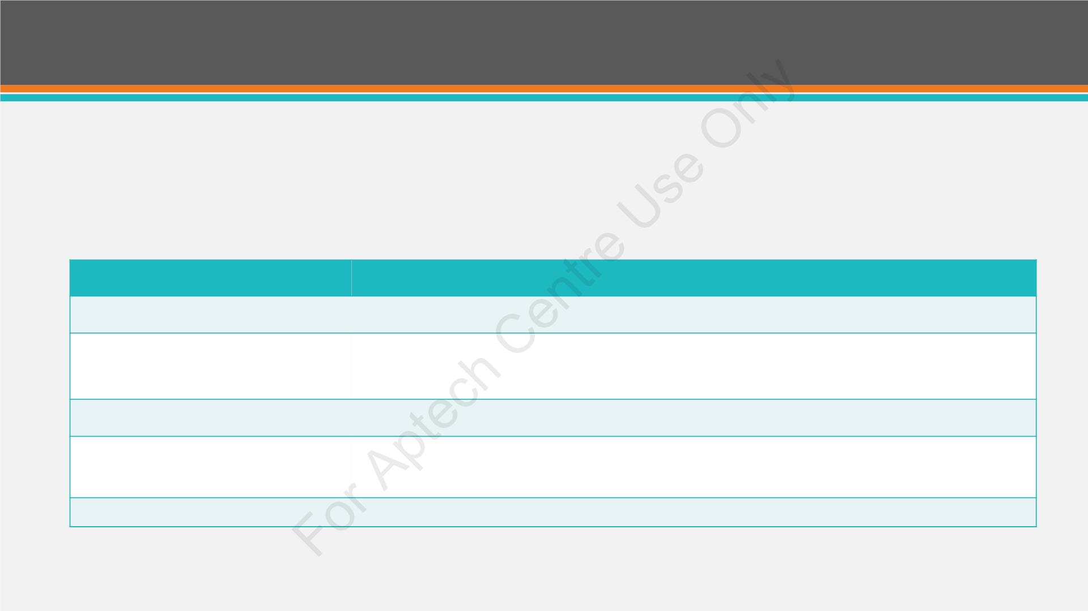
Session State (1-3)
• A new session object is generated whenever a user a esses an ASP.NET
Website.
• 120-bit SessionID is used to track the sessions that are identified.
Properties
Description
SessionID
Is the unique session identifier.
Item(name)
HttpSessionState class has this as default property. It enables the session
state item value with the specified name.
Count
Enables he number of items in session state collection.
TimeOut
Enab s getting and setting the allowed time, in minutes, between
requests and prior to the session-state provider terminating the session.
HttpSessionState Properties
© Aptech Programming for the Web with ASP.NET MVC/Session 5
12

Slide 13
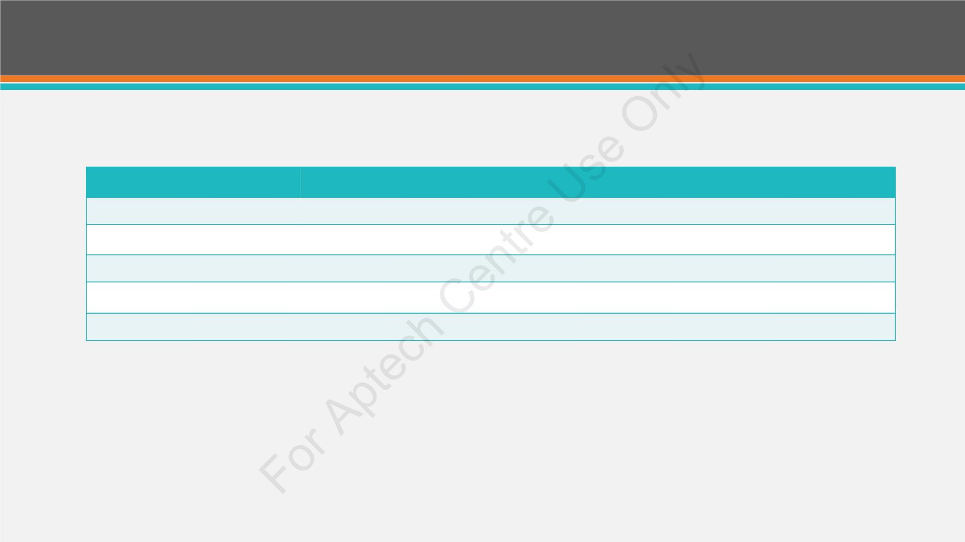
Session State (2-3)
Methods
Description
Add (name, value)
Clear
It adds an item to the session state collection.
Items from session state collection are removed.
Remove(name)
RemoveAll
The specified item from the session state collection is removed.
All keys and values are removed from session-state collection.
RemoveAt
It deletes an item at specified index from the session-state collection.
HttpSessionState Methods
© Aptech Programming for the Web with ASP.NET MVC/Session 5
13

Slide 14
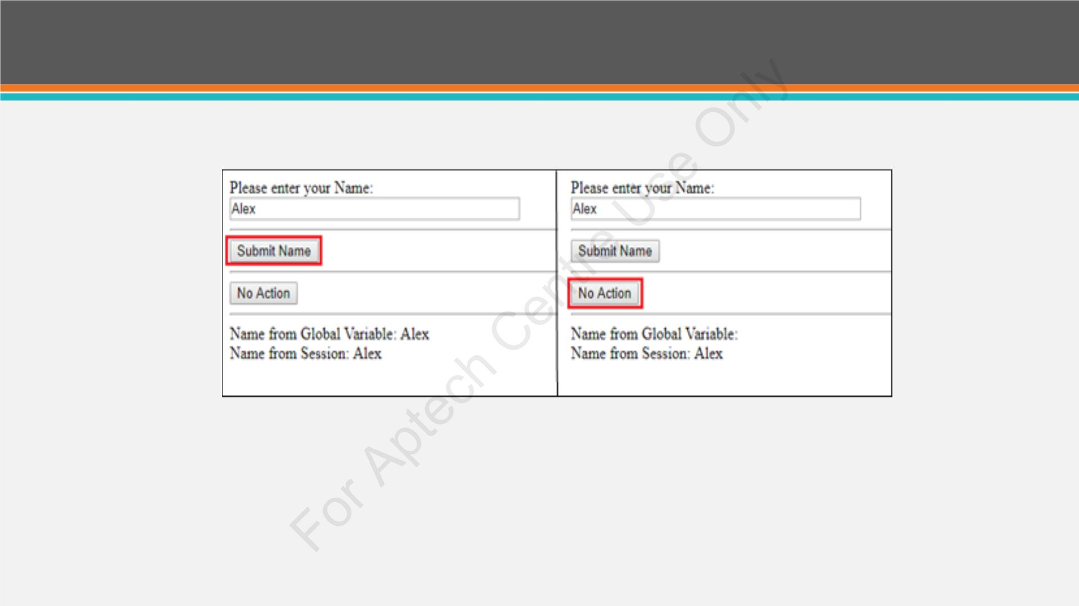
Session State (3-3)
Session State Page Displayed After Button Clicks
© Aptech Programming for the Web with ASP.NET MVC/Session 5
14

Slide 15
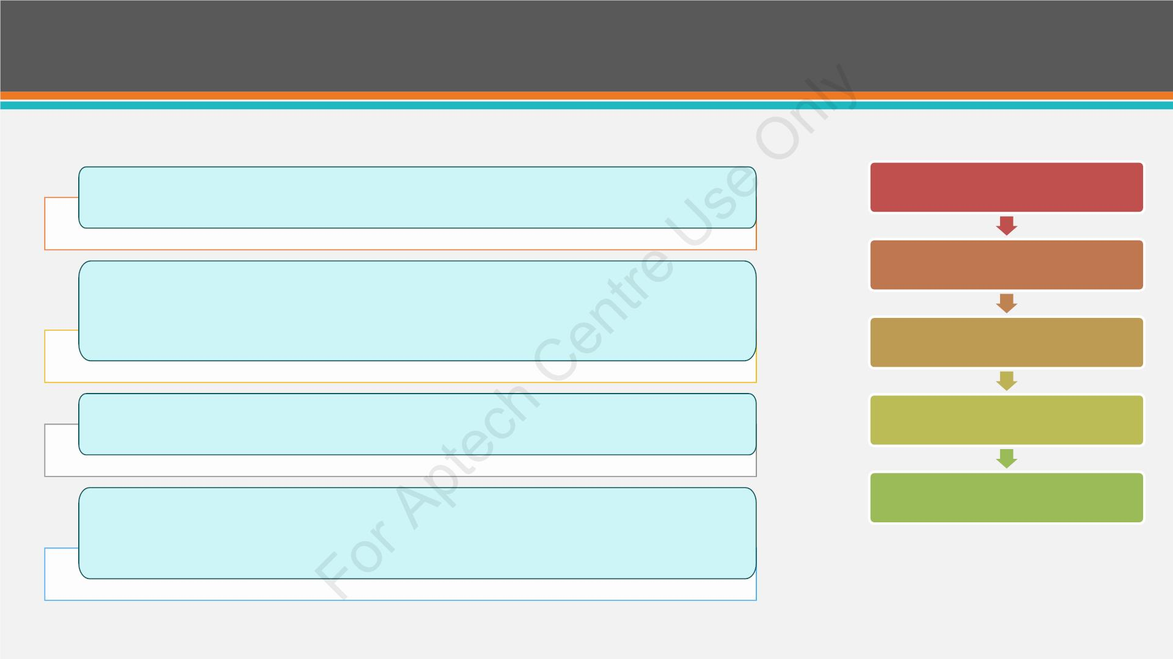
Application State (1-2)
All Web pages, additional files, and code stored on a Web-based
server in a single virtual directory together form an ASP.NET
application.
Application_Start
Application_End
Application_Error
Session_Start
ASP.NET generates an application state object from the
HttpApplicationState class and reserves this object in server
memory. This object is represented by Global.asax.
Whenever information is embedded in application state, it is available
to all the users.
Session_End
Application state is primarily utili ed for purposes such as generating
hit counters, statistical data, or discount rate, to keep track of users
accessing the Website.
© Aptech Programming for the Web with ASP.NET MVC/Session 5
15

Slide 16
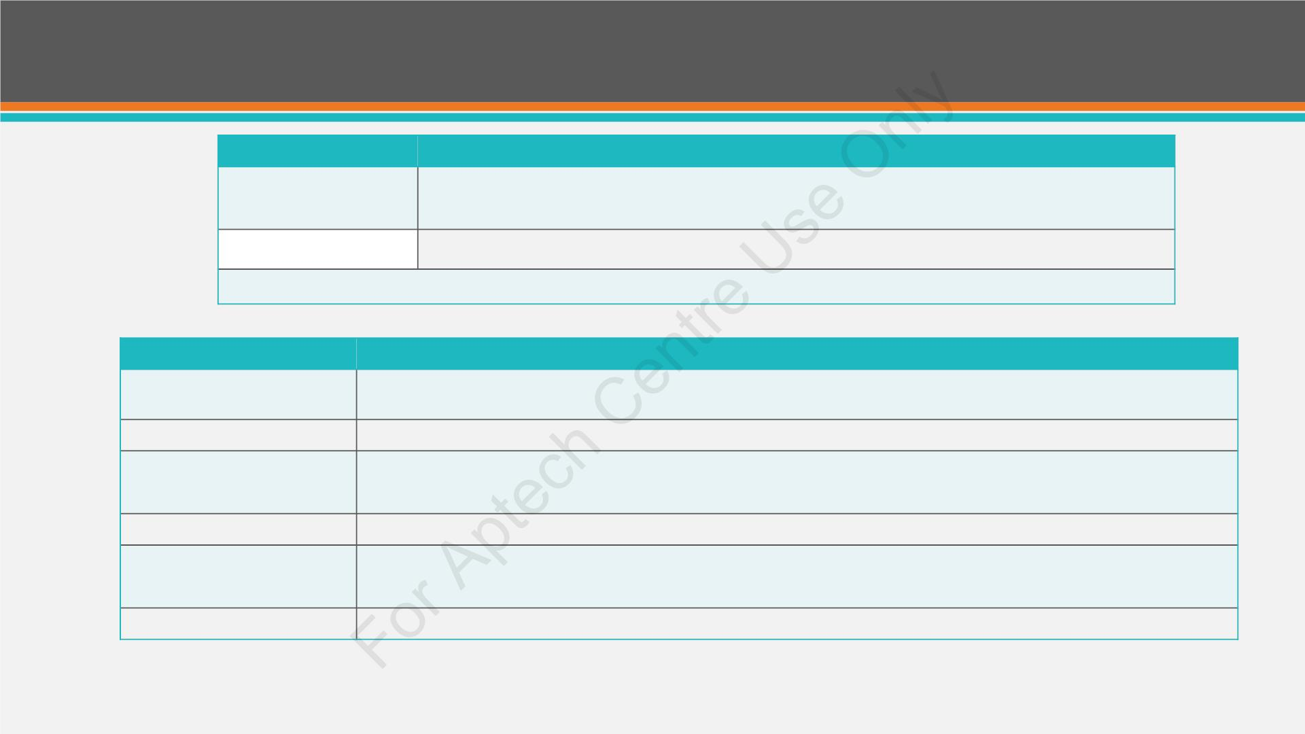
Application State (2-2)
Properties
Descriptio
Is the default property. It specifies the value of the application state
item with the name.
Defines the number of items in the application state collection.
Item(name)
Count
HttpApplicationState Properties
Methods
Description
Add(name, value) Defines how an item is added to the application state collection.
Clear
RemoveAt
Displays how to remove all the items from application state collection.
Defines how to remove a HttpApplicationState object from a collection by
index.
RemoveAll
Lock()
Specifies how to remove all objects from an HttpApplicationState collection.
Specifie how it locks the application state collection so it is available for
current user only.
Unlock()
Dis ays how to unlock the application state collection so that users can access.
HttpApplicationState Methods
© Aptech Programming for the Web with ASP.NET MVC/Session 5
16

Slide 17
Validation Controls (1-5)
• Data entered in input controls is validated usi g Validation controls in
ASP.NET.
• All error messages are specified as property values of validation
controls under System.UI.WebControlsnamespace.
© Aptech Programming for the Web with ASP.NET MVC/Session 5
17

Slide 18
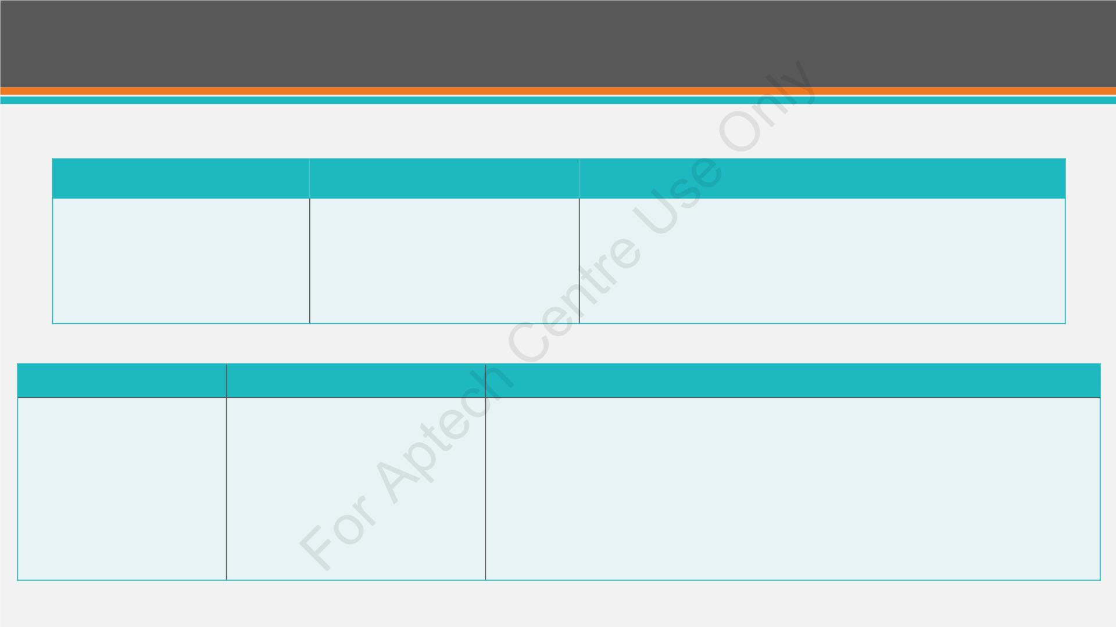
Validation Controls (2-5)
Validation Controls
Description
Properties
RequiredFieldValidator
When this validator is used
against a control, a value is
mandatory.
ControlToValidate: Allocates the control field for validation
such as text box.
Init l Value: Displays a default value in the control. This
property can be used for a drop-down list.
Text: Specifies the text value for the validation control, such as
Name.
Validation Controls
Description
Properties
RangeValidator
Checks if an input control value
is within a specified range of
values.
ControlToValidate: Sets the particular control to validate.
Minimum Value: Holds the minimum valid range value.
Maximum value: Holds the maximum valid range value.
Type: Type properties should be set after the mentioned properties are set, if
It can be used with mobile
number, age, date of birth, and
so on.
required.
String: For a string data type
Integer: For an Integer data type
Double: For a double data type
Currency: For a currency data type
Date: For a date data type
© Aptech Programming for the Web with ASP.NET MVC/Session 5
18

Slide 19
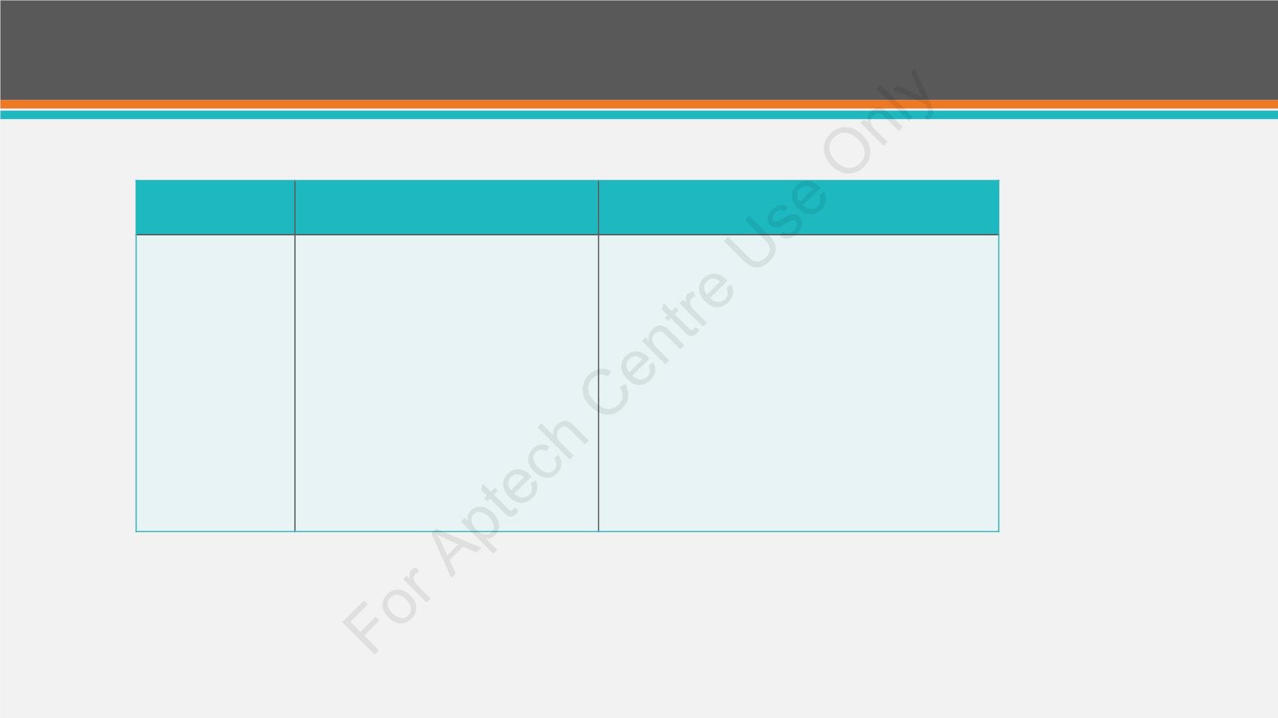
Validation Controls (3-5)
Validation
Controls
Description
Prop rties
CompareValidator
Compares the values of two fields. The
validator shows an error message in
case both controls values are not same.
ControlToValidate: Se s the particular control to
validate.
ControlToCo pare: Compares the value with
ControlToValidate.
Operator: Defines the type of comparison as follows:
• Equal: It checks whether the compared values are
e ual.
• Not Equal: Is used to verify that the controls are not
equal to each other.
• Greater than: Indicates greater than relationship.
• GreaterThanEqual: Indicates
GreaterThanEqual relationship.
• LessThan: Indicates less than relationship.
• LessThanEqual: Indicates less than equal
relationship.
© Aptech Programming for the Web with ASP.NET MVC/Session 5
19

Slide 20
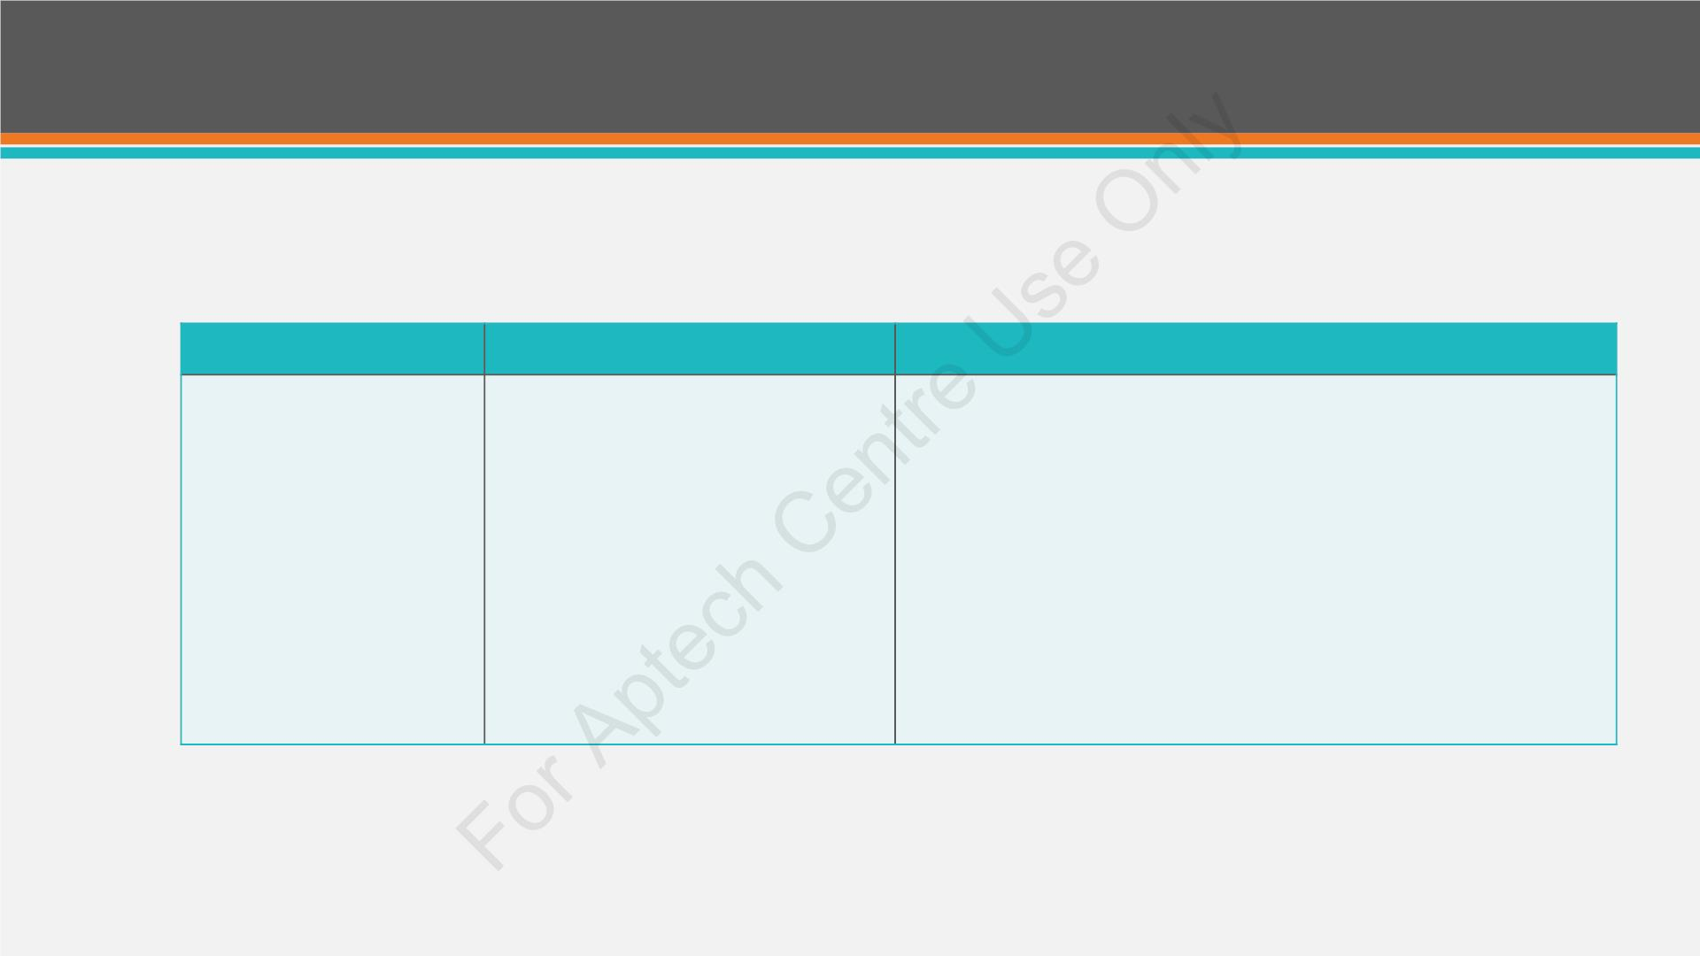
Validation Controls (4-5)
Validation Controls
Description
Properties
RegularExpressionValidator
Checks whether the text matches a
certain pattern.
\d: 0->9] : It takes value zero to nine
\D: It takes a value except [0->9]
\w: It takes value [a->z][A->Z][0->9]
\s: indicates space
\S: it takes other value other than space
{Length}: indicates {min ,max}
[ ]: indicates choice of given character(one out of them)
( ): indicates group of validator
|: OR
Special characters that can be used to define the number of times the
preceded symbol is used:
* : 0 -> indicates more numeric values
+ : 1 --> indicates more numeric values
? : indicates 0(min) or 1 (max)
© Aptech Programming for the Web with ASP.NET MVC/Session 5
20

Slide 21
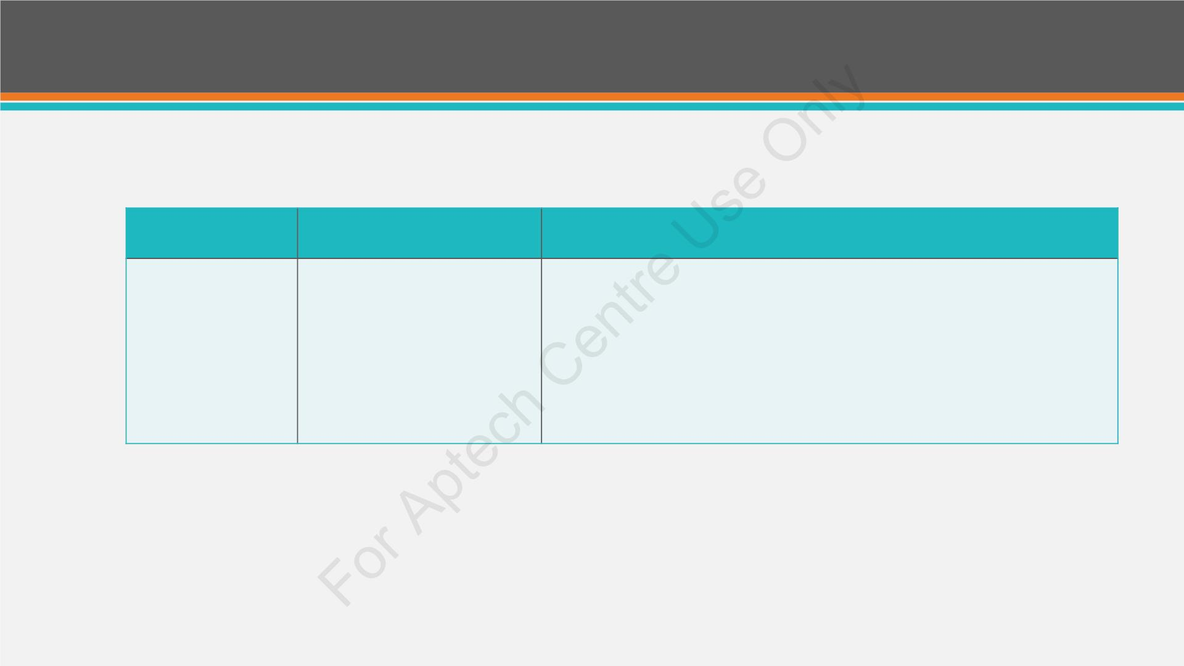
Validation Controls (5-5)
Validation
Controls
Description
Properties
CustomValidator
Used for customizing and
implementing data
ControlToVal date: Utilized to set the control field (text box) for
validation.
validation according to the
specific condition and
requirement.
Vali ateEmptyText: Utilized to set a Boolean value specifying whether
blank text should be validated or not.
ClientValidationFunction: Utilized to allocate the name of specified
client-side script role used for validation.
© Aptech Programming for the Web with ASP.NET MVC/Session 5
21

Slide 22
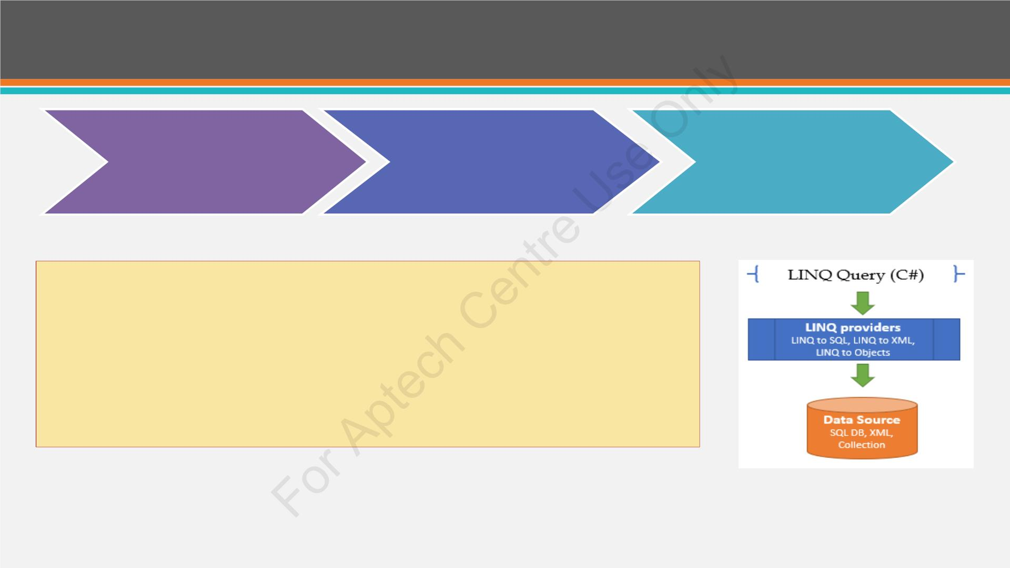
Using LINQ with ASP.NET
LINQ for objects to query
in-memory collections
LINQ for SQL to query
relational databases
LINQ for XML to query
XML data
• LINQ stands for Language Integrated Query.
• It is used to facilitate consistent access to numerous data sources
and XML.
• Custom data providers can be created using the extensibility
feature of LINQ.
LINQ Providers
© Aptech Programming for the Web with ASP.NET MVC/Session 5
22

Slide 23
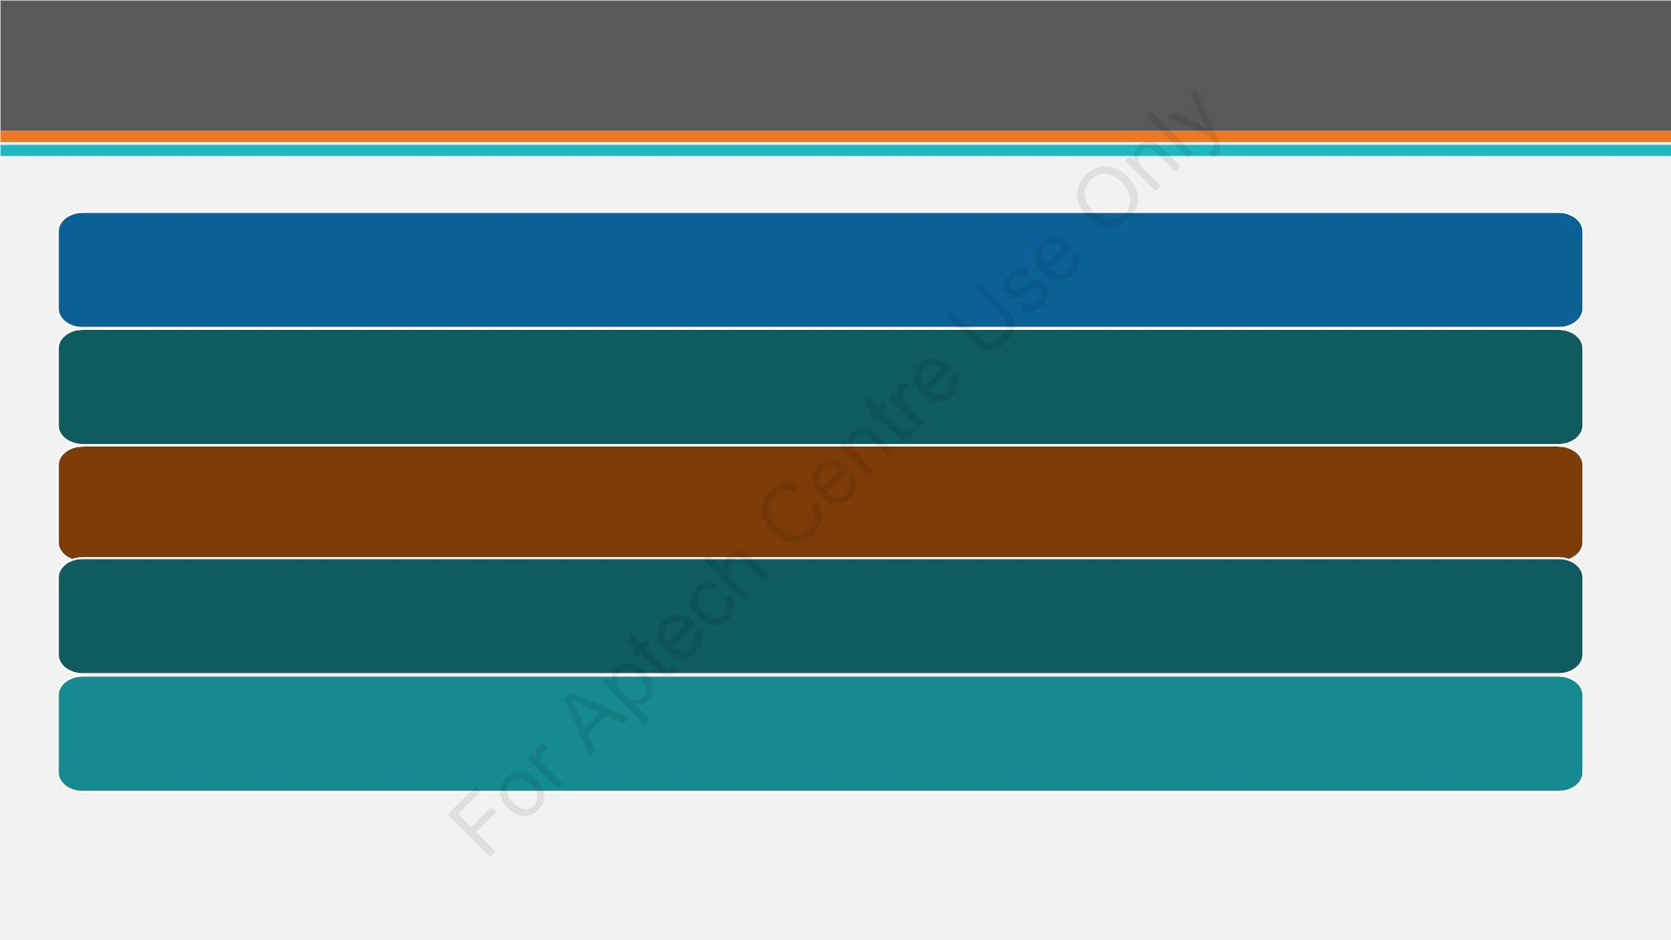
Caching (1-2)
Caching is a process of retaining an in-memory copy of important and mostly used data/information.
The ASP.NET runtime contains a key-value map of CLR objects known as cache.
Cache is accessible through the HttpContextand System.Web.UI.Page.
Items in the cache can be accessed using an indexer.
Lifetime of objects in the cache can be co rolled and links can be set up between the cached objects and their physical
sources.
© Aptech Programming for the Web with ASP.NET MVC/Session 5
23

Slide 24
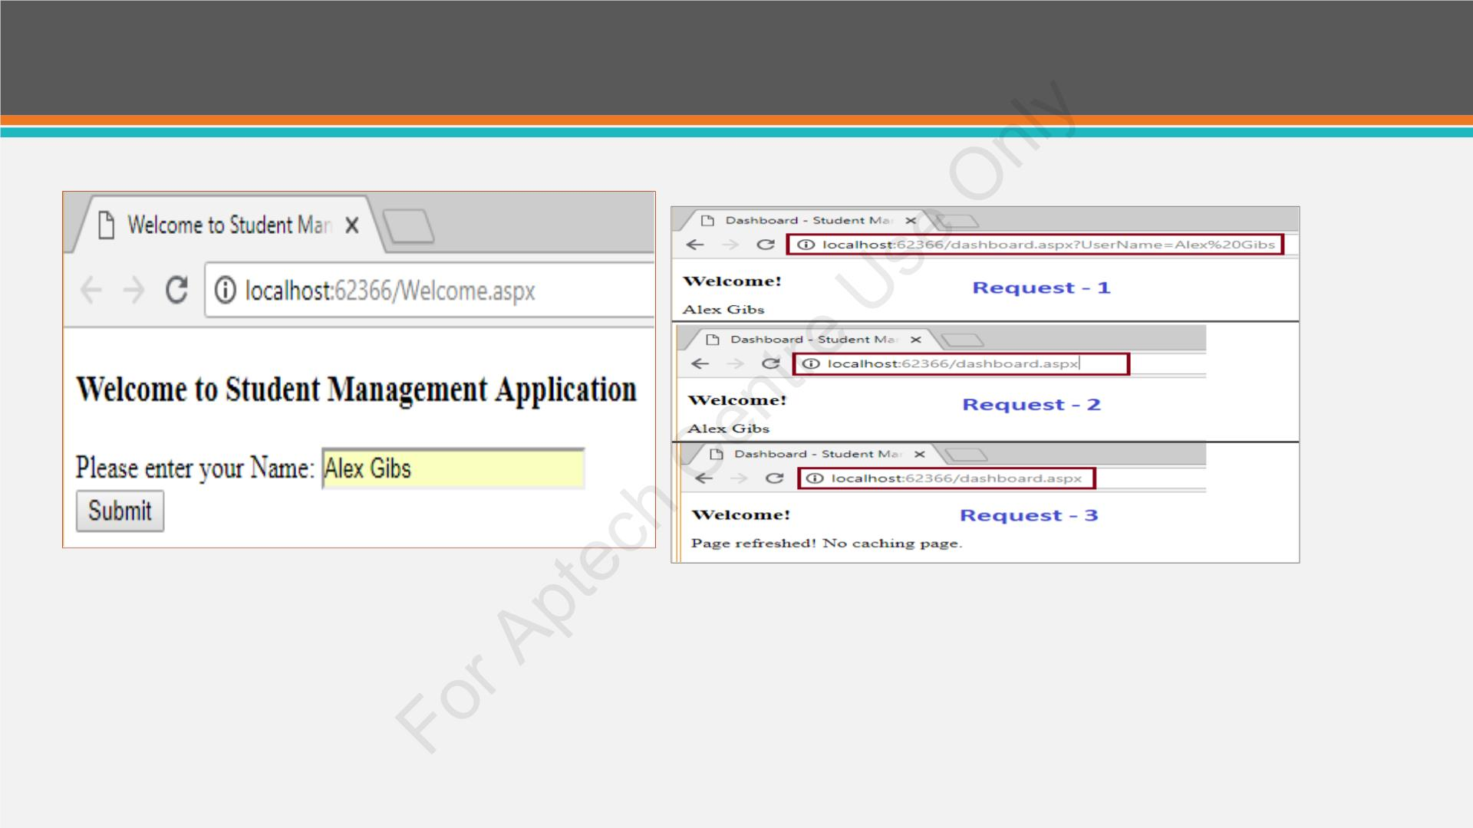
Caching (2-2)
Welcome page
Page Caching Demo
© Aptech Programming for the Web with ASP.NET MVC/Session 5
24

Slide 25
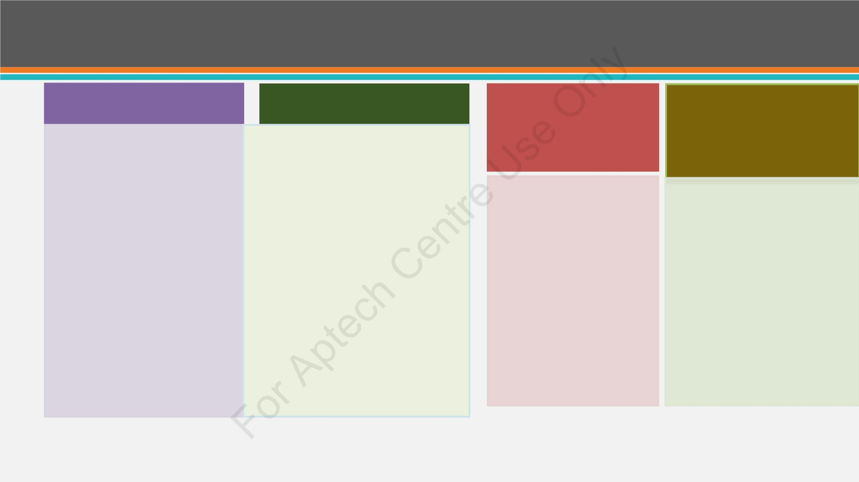
Types of Caching
Output Caching
Data Caching
Fragment Caching
Data Source Caching
Stores a copy of the last Stores information such as
published HTML page. DataTableor DataSet
When the next request fetched from a database.
comes for this page, the Data caching is server
stored copy of HTML is friendly. If cache items
Instead of an entire
HTML, a portion of
it can be cached.
Inbuilt data source
controls such as
ObjectDataSoure,
SqlDataSource, and
XmlDataSource.
dispatched.
become large, they can
be deleted from the
server memory. It can
also be set to expire
automatically.
© Aptech Programming for the Web with ASP.NET MVC/Session 5
25

Slide 26
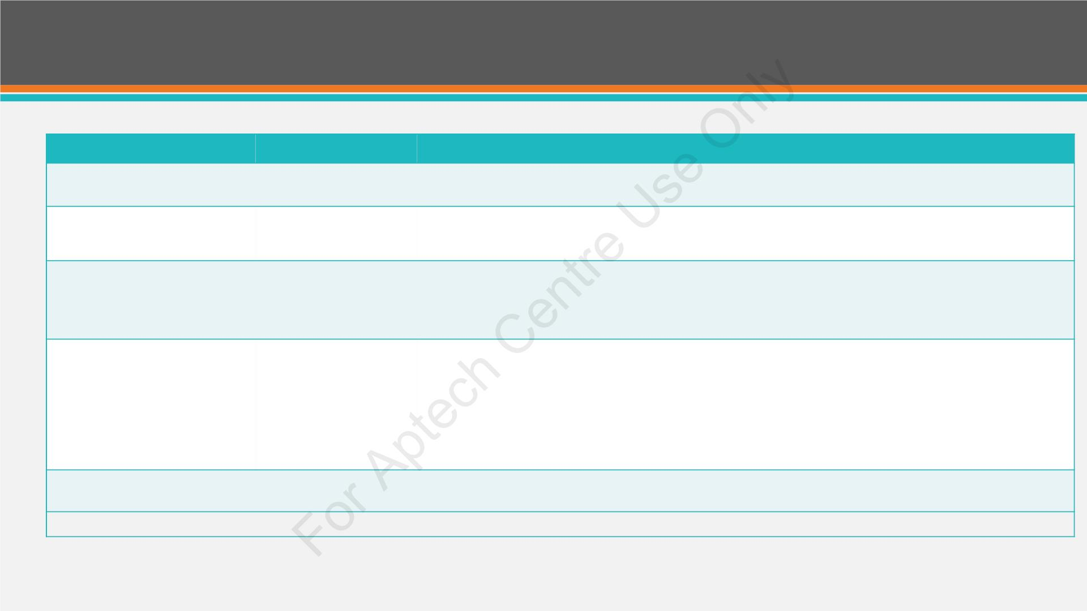
Output Caching
Attribute
Option
Description
NoStore
true/false
It specifies whether the ‘no store’ cache control header is passed or not.
VaryByParam
None
It shows a semicolon-delimited strings list defining query values of
strings in a GET request or POST request variable.
It specifies ASP.NET to differ the output cache by the name of the
browser and its version or through a custom string.
Param-name
Browser
Custom
string
VaryByCustom
Location
Duration
Any
Client
Downstream
Server
None
Specifies which location to store the Cache.
Number
It indicates how many seconds the control or page is cached.
OutputCache Attributes
© Aptech Programming for the Web with ASP.NET MVC/Session 5
26

Slide 27
Data Caching
• Data Caching is the most flexible type of caching.
• Basic principle is to add items that are expensive to create a special built-in
collection object (called cache).
• Cache items are removed automatically when expired.
© Aptech Programming for the Web with ASP.NET MVC/Session 5
27

Slide 28
Summary
➢ State management is a method that manages page informatio nd state over various requests for
the same or different pages.
➢ There are two state management types; the client-side management and server-side state
management.
➢ The session state object stores and retrieves data from the session state. It is referred to as a name-
value pair.
➢ Application state is primarily used to store statistical data and hit counters, and global application
data such as tax and discount rates.
➢ Validation controls are utilized for validating the data supplied in input controls such as text box.
➢ LINQ stands for Language Integrated Query. Three main LINQ providers by Microsoft are
namely, LINQ to objects, LINQ o SQL, and LINQ to XML.
➢ Caching refers to a method of saving an in-memory copy of significant and most-used
data/information for en ancing the software system performance.
➢ There are two types of caching: output caching and data caching.
© Aptech Programming for the Web with ASP.NET MVC/Session 5
28

